Slide 1
Accounting Principles
Thirteenth Edition
Weygandt ● Kimmel ● Kieso
Chapter 6
Inventories
This slide deck contains animations. Please disable animations if they cause issues with your device.

Slide 2
Chapter Outline
Learning Objectives
L O 1 Discuss how to classify and determine inventory.
L O 2 Apply inventory cost flow methods and discuss their financial effects.
L O 3 Indicate the effects of inventory errors on the financial statements.
L O 4 Explain the statement presentation and analysis of inventory.

Slide 3
Classifying and Determining Inventory
Classifying Inventory
Merchandising company
Manufacturing company
One classification:
Merchandise inventory
Three classifications:
Raw materials
Work in process
Finished goods

Slide 4
Determining Inventory Quantities (1 of 2)
Physical Inventory taken for two reasons:
Perpetual System
Check accuracy of inventory records
Determine amount of inventory lost due to wasted raw materials, shoplifting, or employee theft
Periodic System
Determine the inventory on hand at the balance sheet date
Determine the cost of goods sold for the period

Slide 5
Determining Inventory Quantities (2 of 2)
Taking a Physical Inventory
Involves counting, weighing, or measuring each kind of inventory on hand
Companies often “take inventory”
when business is closed or business is slow
at the end of accounting period

Slide 6
Determining Inventory Quantities (3 of 3)
Determining Ownership of Goods
Goods in Transit
Purchased goods not yet received
Sold goods not yet delivered
Included in inventory of company that has legal title to goods

Slide 7
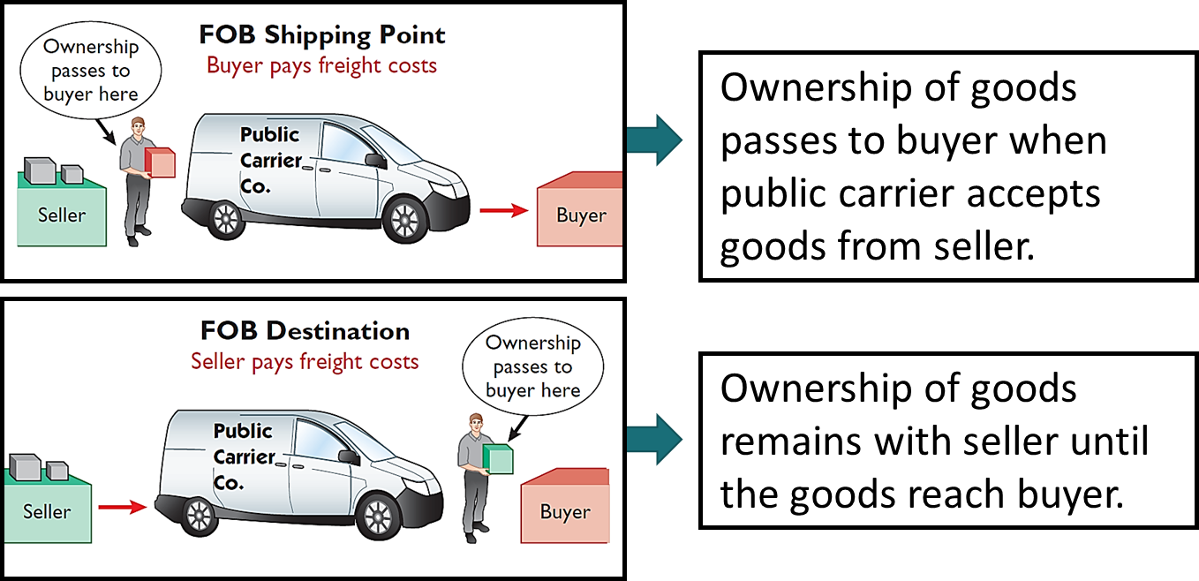
Goods in Transit (1 of 3)
Freight costs incurred by the seller are an operating expense.

Slide 8
Goods in Transit (2 of 3)
Goods in transit should be included in the inventory of the buyer when the:
a. public carrier accepts the goods from the seller
b. goods reach the buyer
c. terms of sale are F O B destination
d. terms of sale are F O B shipping point

Slide 9
Goods in Transit (3 of 3)
Goods in transit should be included in the inventory of the buyer when the:
a. public carrier accepts the goods from the seller
b. goods reach the buyer
c. terms of sale are F O B destination
d. Answer: terms of sale are F O B shipping point

Slide 10
Determining Ownership of Goods
Consigned Goods
Goods of other parties held by the company for sale; ownership of the goods remains with other parties –company earns a fee for sale.
Many car, boat, and antique dealers sell goods on consignment to:
keep inventory costs down
avoid risk of purchasing an item that they will not be able to sell

Slide 11
Do It! 1: Rules of Ownership
Hasbeen Company completed its inventory count. It arrived at a total inventory value of $200,000. As a new member of Hasbeen’s accounting department, you have been given the information listed below. Discuss how this information affects the reported cost of inventory.
Hasbeen included in the inventory goods held on consignment for Falls Co., costing $15,000.
The company did not include in the count purchased goods of $10,000 which were in transit (terms: F O B shipping point).
The company did not include in the count sold inventory with a cost of $12,000 which was in transit (terms: F O B shipping point).
Inventory =
$200,000
− $15,000
+ $10,000
= $195,000

Slide 12
Inventory Methods and Financial Effects (1 of 2)
Inventory is accounted for at cost
Includes all expenditures necessary to acquire goods and place them in a condition ready for sale
Unit costs are applied to quantities to compute total cost of inventory and cost of goods sold using the following cost flow assumptions:
Specific identification
First-in, first-out (F I F O)
Last-in, first-out (L I F O)
Average-cost

Slide 13
Inventory Methods and Financial Effects (2 of 2)
Illustration: Crivitz TV Company purchases three identical 50-inch TVs on different dates at costs of $720, $750, and $800. During the year Crivitz sold two sets at $1,200 each. These facts are summarized below.
Purchases
February 3 | 1 TV | at | $720
March 5 | 1 TV | at | $750
May 22 | 1 TV | at | $800
Sales
June 1 | 2 TVs | For | $2,400 ($1,200 × 2)

Slide 14
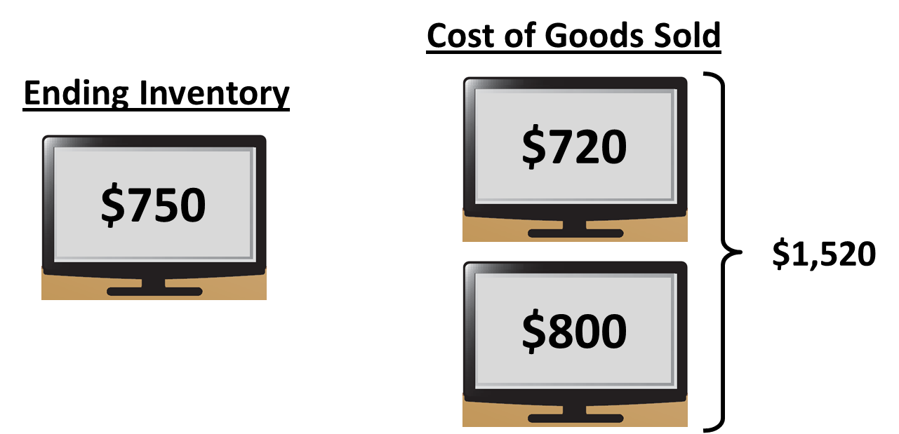
Specific Identification (1 of 2)
If Crivitz sold the TVs it purchased on February 3 and May 22, then its cost of goods sold is $1,520 ($720 + $800), and its ending inventory is $750.

Slide 15
Specific Identification (2 of 2)
Possible only when a company sold a limited variety of high-unit-cost items that could be identified clearly from the time of purchase through the time of sale.
Practice is relatively rare.
Most companies make assumptions (cost flow assumptions) about which units were sold.

Slide 16
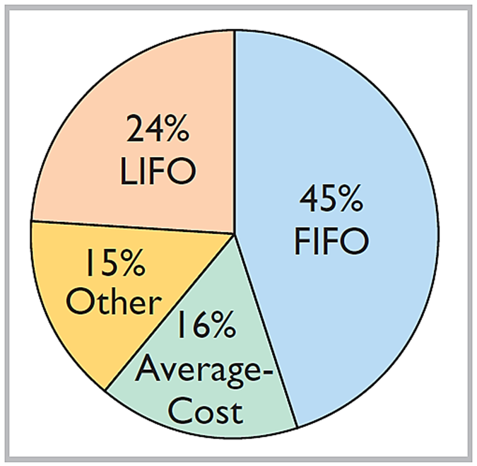
Cost Flow Assumptions (1 of 9)
Cost flow assumptions DO NOT need to be consistent with the physical movement of the goods

Slide 17
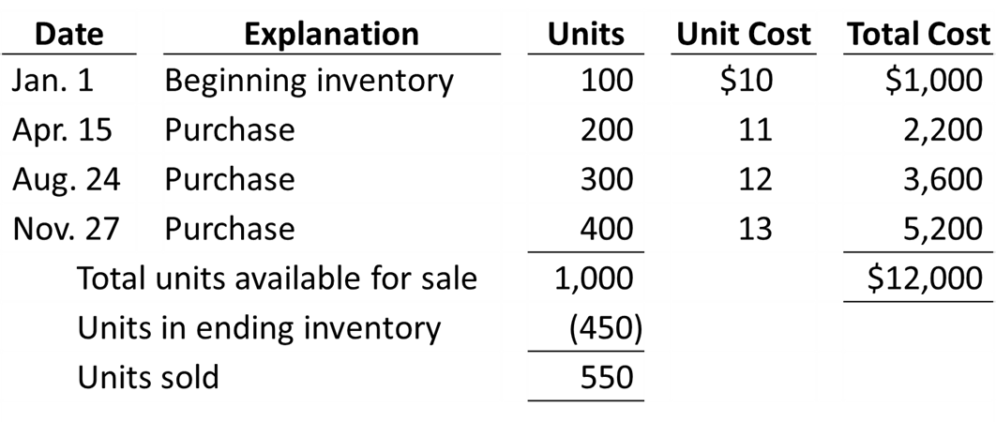
Cost Flow Assumptions (2 of 9)
Illustration: Data for Houston Electronics’ Astro condensers.
Cost of goods sold formula in a periodic system is:
Beginning Inventory + Purchases − Ending Inventory = Cost of Goods Sold

Slide 18
Cost Flow Assumptions (3 of 9)
First-In, First-Out (F I F O)
Costs of earliest goods purchased are first to be recognized in determining cost of goods sold
Often parallels actual physical flow of merchandise
Companies determine cost of ending inventory by taking unit cost of most recent purchase and working backward until all units of inventory have been costed

Slide 19
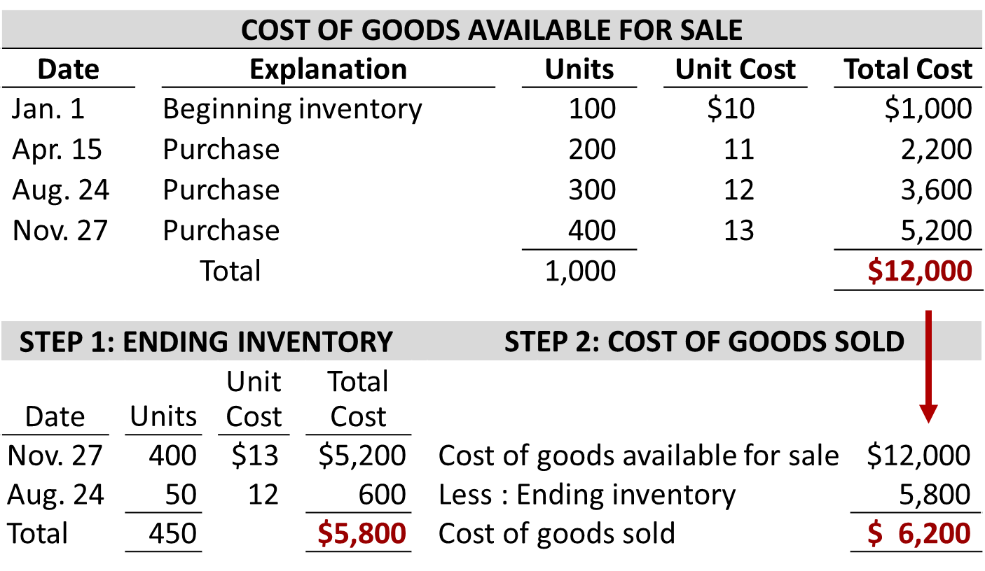
First-In, First-Out (FIFO) (1 of 2)

Slide 20
Cost Flow Assumptions (4 of 9)
Last-In, First-Out (L I F O)
Costs of latest goods purchased are first to be recognized in determining cost of goods sold
Seldom coincides with actual physical flow of merchandise
Exceptions include goods stored in piles, such as coal or hay

Slide 21
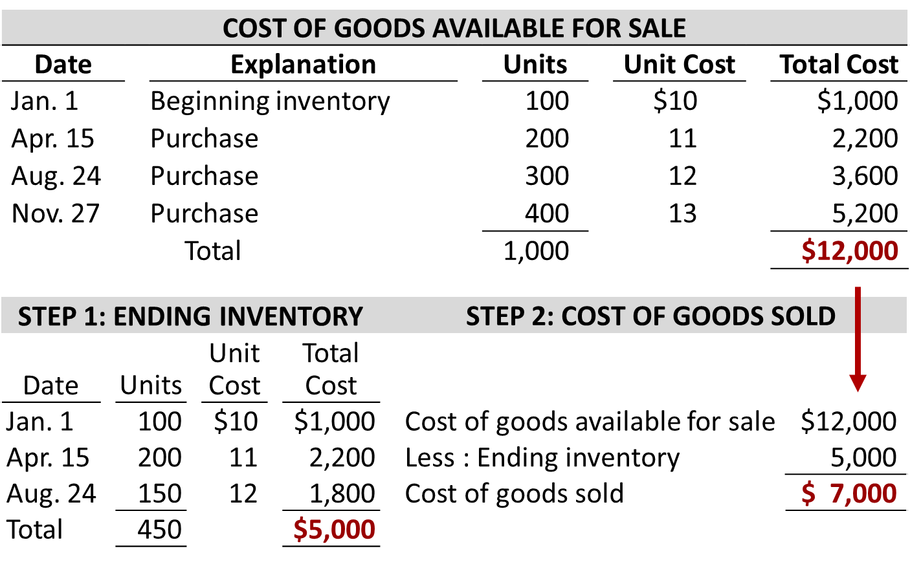
Last-In, First-Out (L I F O)

Slide 22
Cost Flow Assumptions (5 of 9)
Average-Cost
Allocates cost of goods available for sale on basis of weighted-average unit cost incurred
Applies weighted-average unit cost to units on hand to determine cost of ending inventory

Slide 23
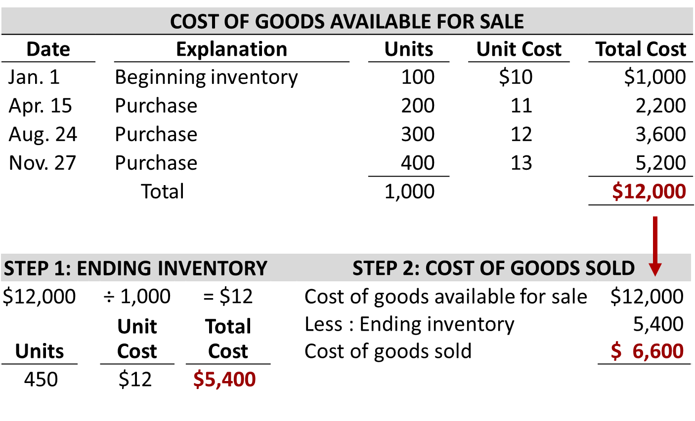
Average-Cost

Slide 24
Financial Statement and Tax Effects of Cost Flow Methods
Each of the three cost flow methods is acceptable for use.
Reebok International Ltd. and Wendy’s International currently use the F I F O method
Campbell Soup Company, Krogers, and Walgreen Drugs use L I F O for part or all of their inventory
Bristol-Myers Squibb, Starbucks, and Motorola use the average-cost method
Stanley Black & Decker Manufacturing Company uses L I F O for domestic inventories and F I F O for foreign inventories

Slide 25
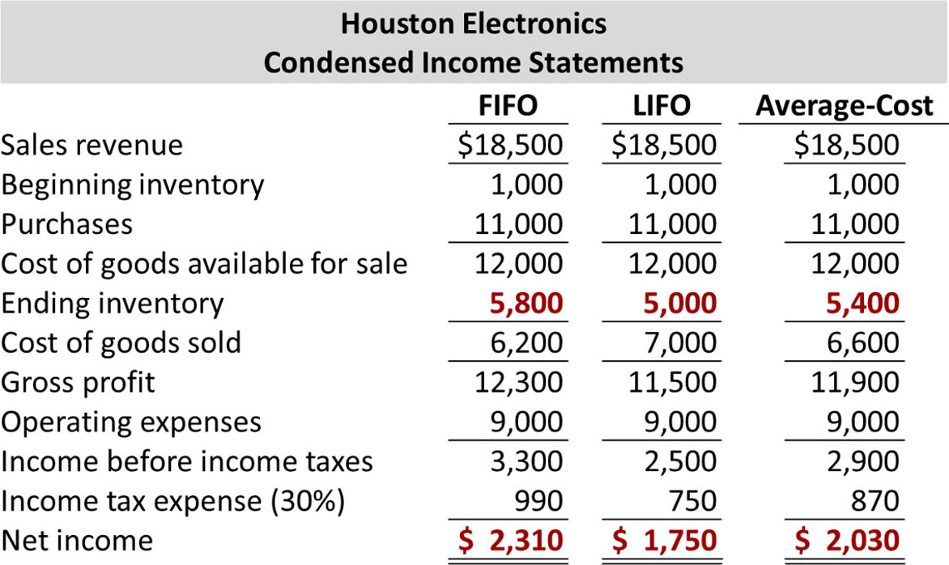
Income Statement Effects (1 of 5)

Slide 26
Balance Sheet Effects (1 of 2)
A major advantage of the F I F O method is that in a period of inflation, costs allocated to ending inventory will approximate their current cost
A major shortcoming of the L I F O method is that in a period of inflation, costs allocated to ending inventory may be significantly understated in terms of current cost

Slide 27
Tax Effects
Both inventory and net income are higher when companies use F I F O in a period of inflation
L I F O results in the lowest income taxes (because of lower net income) during times of rising prices
A tax rule requires that if companies use L I F O for tax purposes they must also use it for financial reporting purposes (L I F O conformity rule)

Slide 28
Using Inventory Cost Flow Methods Consistently
Method should be used consistently to enhance comparability
Although consistency is preferred, a company may change its inventory costing method
Quaker Oats Notes to the Financial Statements
Note 1: Effective July 1, the Company adopted the L I F O cost flow assumption for valuing the majority of U.S. Grocery Products inventories. The Company believes that the use of the L I F O method better matches current costs with current revenues. The effect of this change on the current year was to decrease net income by $16.0 million.

Slide 29
Cost Flow Assumptions (6 of 9)
The cost flow method that often parallels the actual physical flow of merchandise is the:
a. F I F O method
b. L I F O method
c. average cost method
d. gross profit method

Slide 30
Cost Flow Assumptions (7 of 9)
The cost flow method that often parallels the actual physical flow of merchandise is the:
a. Answer: F I F O method
b. L I F O method
c. average cost method
d. gross profit method

Slide 31
Cost Flow Assumptions (8 of 9)
In a period of inflation, the cost flow method that results in the lowest income taxes is the:
a. F I F O method
b. L I F O method
c. average cost method
d. gross profit method

Slide 32
Cost Flow Assumptions (9 of 9)
In a period of inflation, the cost flow method that results in the lowest income taxes is the:
a. F I F O method
b. Answer: L I F O method
c. average cost method
d. gross profit method

Slide 33
Do It! 2: Cost Flow Methods
The accounting records of Shumway Ag Implements show the following data.
Beginning inventory | 4,000 units at $ 3
Purchases | 6,000 units at $ 4
Sales | 7,000 units at $12
Determine the cost of goods sold during the period under a periodic inventory system using (a) the F I F O method, (b) the L I F O method, and (c) the average-cost method.

Slide 34
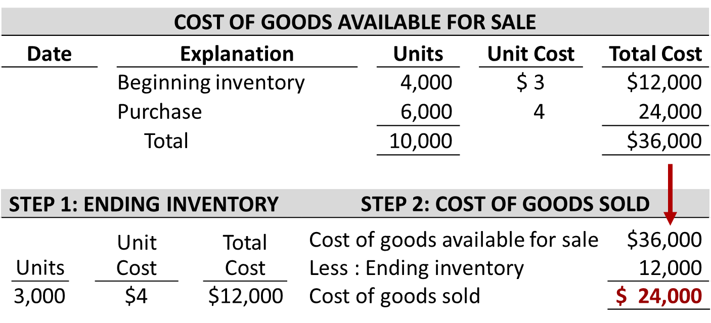
Do It! 2: FIFO Method
Determine cost of goods sold under a periodic inventory.

Slide 35
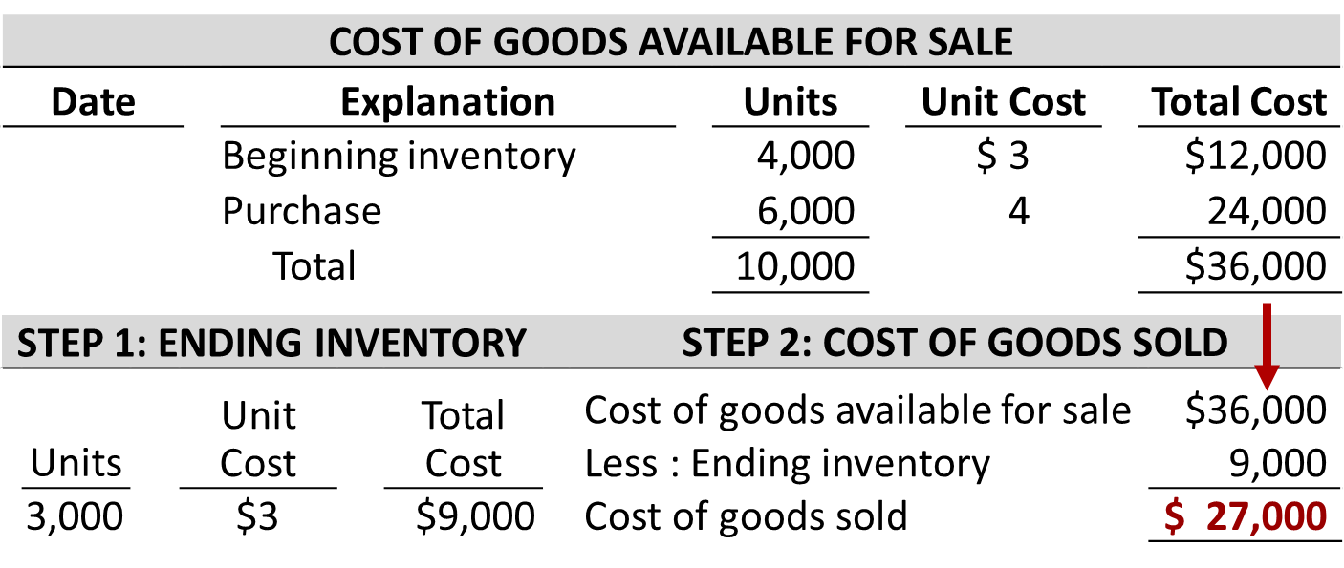
Do It! 2: LIFO Method
Determine cost of goods sold under a periodic inventory.

Slide 36
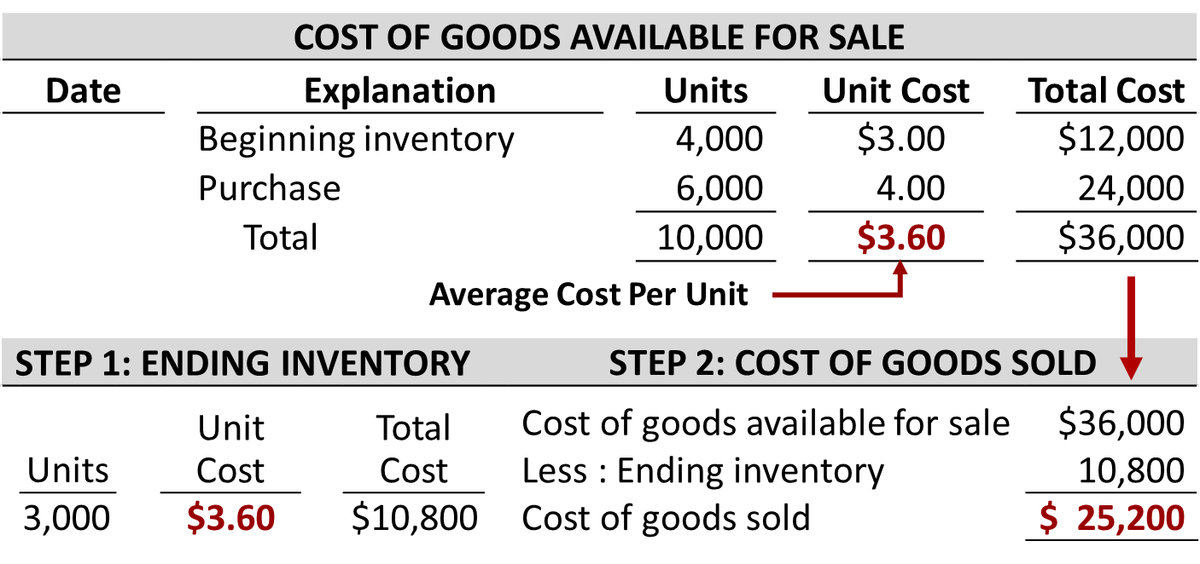
Do It! 2: Average-Cost Method
Determine cost of goods sold under a periodic inventory.

Slide 37
Effects of Inventory Errors (1 of 2)
Common Cause:
Failure to count or price inventory correctly
Not properly recognizing the transfer of legal title to goods in transit
Errors affect both the income statement and balance sheet

Slide 38
Effects of Inventory Errors (2 of 2)
Inventory errors affect the computation of cost of goods sold and net income in two periods.
Beginning Inventory | + | Cost of Goods Purchased | − | Ending Inventory | = | Cost of Goods Sold
When Inventory Error: | Cost of Goods Sold Is: | Net Income Is:
Understates beginning inventory | Understated | Overstated
Overstates beginning inventory | Overstated | Understated
Understates ending inventory | Overstated | Understated
Overstated ending inventory | Understated | Overstated

Slide 39
Income Statement Effects (2 of 5)
Inventory errors affect the computation of cost of goods sold and net income in two periods.
An error in ending inventory of current period will have a reverse effect on net income of next accounting period
Over two years, total net income is correct because errors offset each other
Ending inventory depends entirely on accuracy of taking and costing inventor

Slide 40
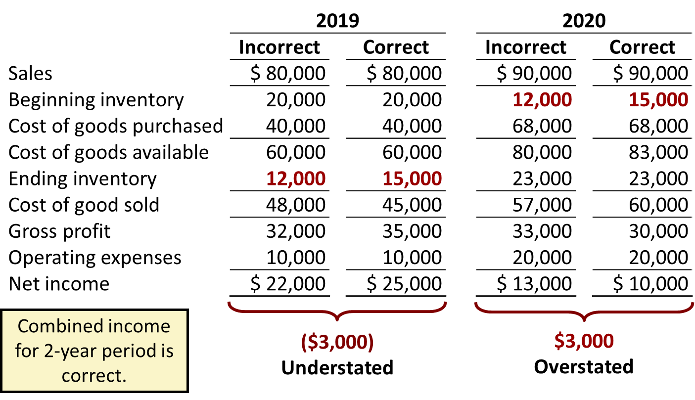
Income Statement Effects (3 of 5)

Slide 41
Income Statement Effects (4 of 5)
Understating ending inventory will overstate:
a. assets
b. cost of goods sold
c. net income
d. stockholders’ equity

Slide 42
Income Statement Effects (5 of 5)
Understating ending inventory will overstate:
a. assets
b. Answer: cost of goods sold
c. net income
d. stockholders’ equity

Slide 43
Balance Sheet Effects (2 of 2)
Effect of inventory errors on the balance sheet is determined by using the basic accounting equation: Assets = Liabilities + Stockholders’ Equity.
Errors in the ending inventory have the following effects.
Ending Inventory Error | Assets | Liabilities | Stockholders’ Equity
Overstated Understated | Overstated Understated | No effect No effect | Overstated Understated

Slide 44
Do It! 3: Inventory Errors
Visual Company overstated its 2019 ending inventory by $22,000. Determine the impact this error has on ending inventory, cost of goods sold, and owner’s equity in 2019 and 2020.
Solution
 | 2019 | 2020
Ending inventory | $22,000 overstated | No effect
Cost of goods sold | $22,000 understated | $22,000 overstated
Owner’s equity | $22,000 overstated | No effect

Slide 45
Statement Presentation and Analysis (1 of 2)
Presentation
Balance Sheet - Inventory classified as current asset.
Income Statement - Cost of goods sold subtracted from net sales.
There also should be disclosure of
major inventory classifications
basis of accounting (cost or L C M)
cost method (F I F O, L I F O, or average-cost)

Slide 46
Lower-of-Cost-or-Net Realizable Value (1 of 2)
When the value of inventory is lower than its cost
Companies must “write down” inventory to its net realizable value
Net realizable value: Amount that company expects to realize (receive from the sale of inventory)
Example of conservatism

Slide 47
Lower-of-Cost-or-Net Realizable Value (2 of 2)
Illustration: Assume that Ken Tuckie TV has the following lines of merchandise with costs and market values as indicated.
 | Units | Cost per Unit | Net Realizable Value per Unit | Lower-of-Cost-or-Net Realizable Value
Flat-screen TVs | 100 | $600 | $550 | $ 55,000 ($550 × 100)
Satellite radios | 500 | 90 | 104 | 45,000 ($90 × 500)
D V D recorders | 850 | 50 | 48 | 40,800 ($48 × 850)
D V Ds | 3,000 | 5 | 6 | 15,000 ($5 × 3,000)
Total inventory |  |  |  | $155,800

Slide 48
Statement Presentation and Analysis (2 of 2)
Analysis
Inventory management is a double-edged sword
High Inventory Levels - may incur high carrying costs (e.g., investment, storage, insurance, obsolescence, and damage).
Low Inventory Levels – may lead to stock-outs and lost sales.

Slide 49
Analysis (1 of 2)
Inventory turnover measures the number of times on average the inventory is sold during the period.
Days in inventory measures the average number of days inventory is held.

Slide 50
Analysis (2 of 2)
Illustration: Wal-Mart reported in its 2016 annual report a beginning inventory of $45,141 million, an ending inventory of $44,469 million, and cost of goods sold for the year ended January 31, 2016, of $360,984 million. The inventory turnover formula and computation for Wal-Mart are shown below.
Cost of Goods Sold | ÷ | Average Inventory | = | Inventory Turnover
$360,984 | ÷ |  | = | 8.1 Times
Days in inventory = 365 ÷ 8.1 = 45.1 Days

Slide 51
Do It! 4: L C N R V and Inventory Turnover
Tracy company sells three different types of home heating stoves (gas, wood, and pellet). The cost and net realizable value of its inventory of stoves are as follows
 | Cost | Net Realizable Value
Gas | $ 84,000 | $ 79,000
Wood | 250,000 | 280,000
Pellet | 112,000 | 101,000
Determine the value of the company’s inventory under the lower-of-cost-or-net realizable value approach.
Solution: The lowest value for each inventory type is gas $79,000, wood $250,000, and pellet $101,000. The total inventory value is the sum of these amounts, $430,000.

Slide 52
Do It! 4: Inventory Turnover (1 of 2)
Early in 2020, Westmoreland Company switched to a just-in-time inventory system. Its sales revenue, cost of goods sold, and inventory amounts for 2019 and 2020 are shown below.
 | 2019 | 2020
Sales revenue | $2,000,000 | $1,800,000
Cost of goods sold | 1,000,000 | 910,000
Beginning inventory | 290,000 | 210,000
Ending inventory | 210,000 | 210,000
Determine the inventory turnover and days in inventory for 2019 and 2020. Discuss the changes in the amount of inventory, the inventory turnover and days in inventory, and the amount of sales across the two years.

Slide 53
Do It! 4: Inventory Turnover (2 of 2)
Solution:
 | 2019 | 2020
Inventory Turnover
Days in inventory | 365 ÷ 4 = 91.3 Days | 365 ÷ 7 = 52.1 Days
The company experienced a very significant decline in its ending inventory as a result of the just-in-time inventory. This decline improved its inventory turnover and its days in inventory. However, its sales declined by 10%. It is possible that this decline was caused by the dramatic reduction in the amount of inventory that was on hand, which increased the likelihood of “stock-outs.” To determine the optimal inventory level, management must weigh the benefits of reduced inventory against the potential lost sales caused by stock-outs.

Slide 54
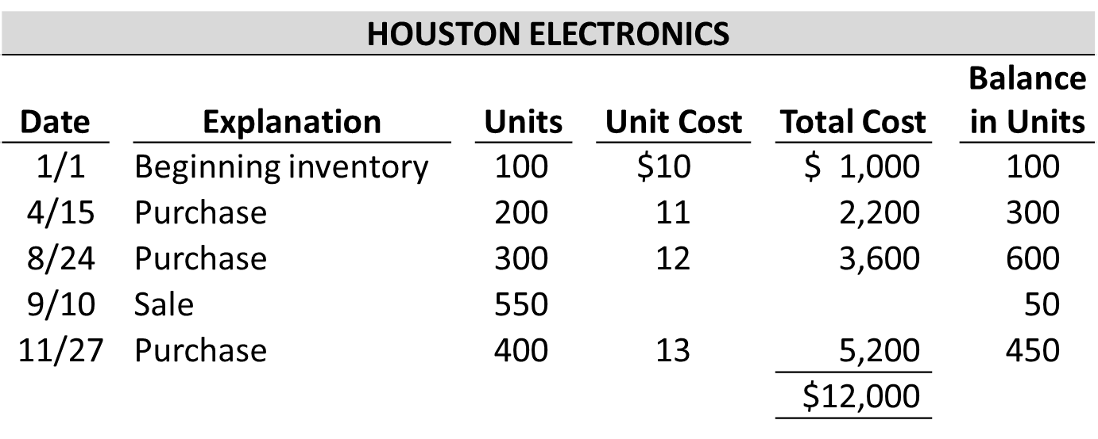
Appendix 6A: Inventory Methods and the Perpetual System
Illustration: Compute Cost of Goods Sold and Ending Inventory under F I F O, L I F O, and average-cost.

Slide 55
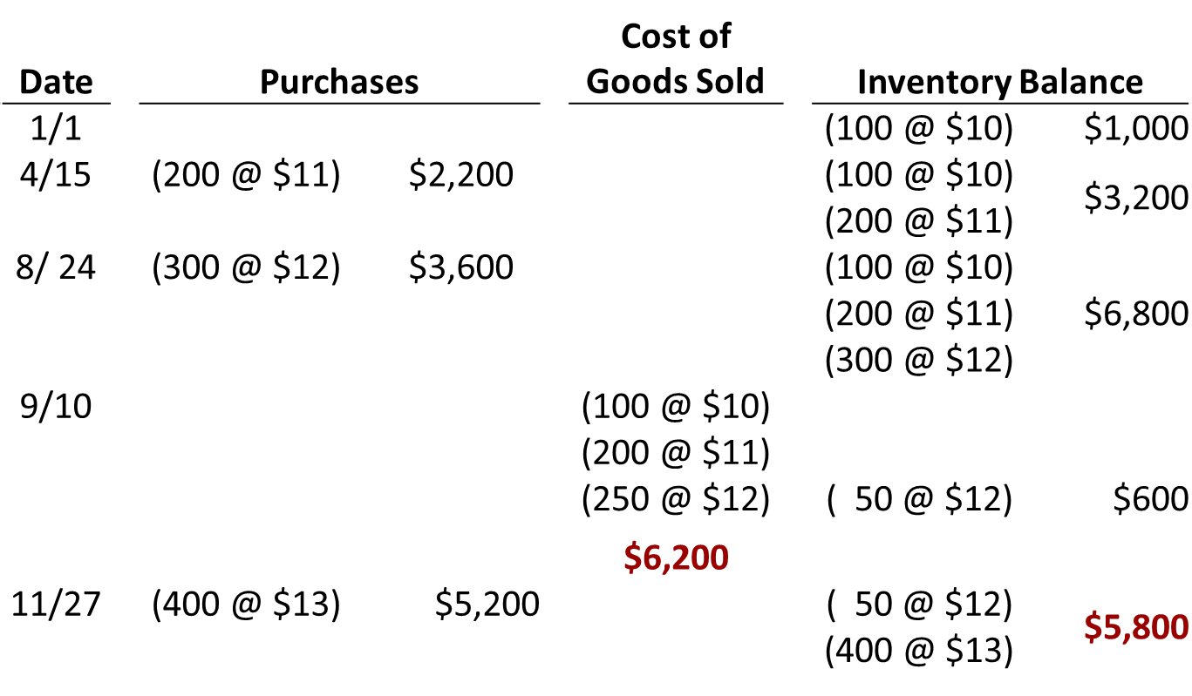
First-In, First-Out (F I F O) (2 of 2)

Slide 56

Last-In, First-Out (F I F O)

Slide 57
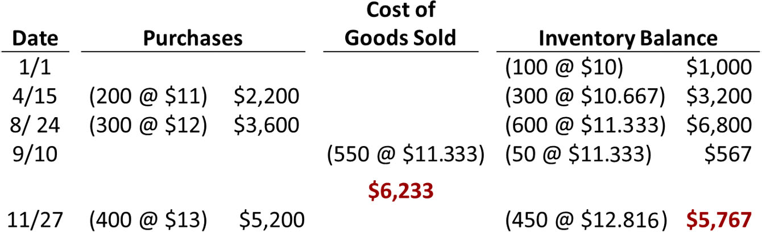
Moving Average

Slide 58
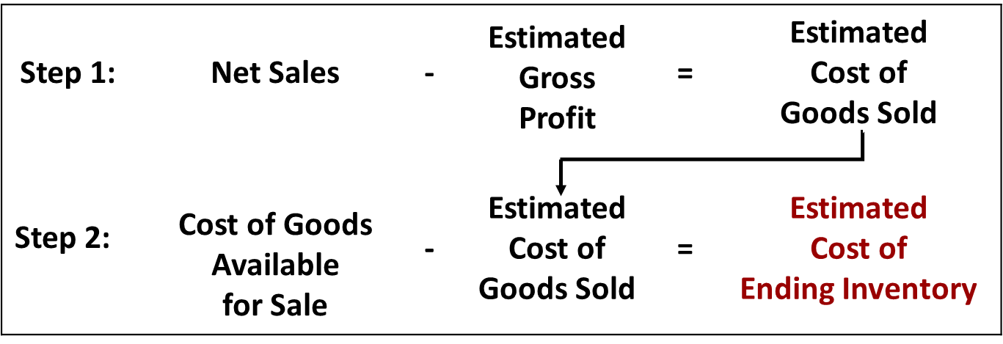
Appendix 6B: Estimating Inventories
Gross Profit Method
A method of estimating the cost of ending inventory by applying a gross profit rate to net sales.

Slide 59
Gross Profit Method (1 of 2)
Illustration: Kishwaukee Company records show net sales of $200,000, beginning inventory $40,000, and cost of goods purchased $120,000. In the preceding year, the company realized a 30% gross profit rate. It expects to earn the same rate this year. Compute the estimated cost of the ending inventory at January 31 under the gross profit method.

Slide 60
Gross Profit Method (2 of 2)
Illustration: Compute the estimated cost of the ending inventory at January 31 under the gross profit method.
Step 1:
Net sales | $200,000
Less: Estimated gross profit (30% × $200,000) | 60,000
Estimated cost of goods sold | $140,000
Step 2:
Beginning inventory | $ 40,000
Cost of goods purchased | 120,000
Cost of goods available for sale | 160,000
Less: Estimated cost of goods sold | 140,000
Estimated cost of ending inventory | $ 20,000

Slide 61
Retail Inventory Method (1 of 2)
Retail companies establish a relationship between cost and sales price
Applies cost-to-retail percentage to ending inventory at retail prices to determine inventory at cost
Step 1: | Goods Available for Sale at Retail | − | Net Sales | = | Ending Inventory at Retail
Step 2: | Goods Available for Sale at Cost | ÷ | Goods Available for Sale at Retail | = | Cost-to- Retail Ratio
Step 3: | Ending Inventory at Retail | x | Cost-to- Retail Ratio | = | Estimated Cost of Ending Inventory

Slide 62
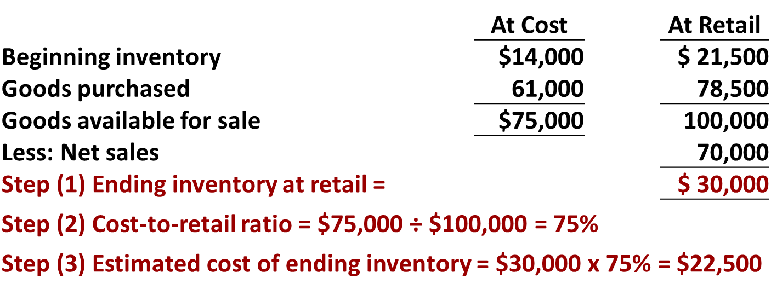
Retail Inventory Method (2 of 2)
Illustration: It is not necessary to take a physical inventory to determine the estimated cost of goods on hand at any given time.

Slide 63
A Look at I F R S (1 of 3)
Key Points
Similarities
I F R S and G A A P account for inventory acquisitions at historical cost and value inventory at the lower-of-cost-or-net-realizable value subsequent to acquisition.
Who owns the goods—goods in transit or consigned goods—as well as the costs to include in inventory are essentially accounted for the same under IFRS and G A A P.

Slide 64
A Look at I F R S (2 of 3)
Key Points
Differences
The requirements for accounting for and reporting inventories are more principles-based under I F R S. That is, G A A P provides more detailed guidelines in inventory accounting.
A major difference between I F R S and G A A P relates to the L I F O cost flow assumption. G A A P permits the use of L I F O for inventory valuation. I F R S prohibits its use. F I F O and average-cost are the only two acceptable cost flow assumptions permitted under I F R S. Both sets of standards permit specific identification where appropriate.

Slide 65
A Look at I F R S (3 of 3)
Looking to the Future
One convergence issue that will be difficult to resolve relates to the use of the L I F O cost flow assumption. As indicated, IFRS specifically prohibits its use. Conversely, the L I F O cost flow assumption is widely used in the United States because of its favorable tax advantages. In addition, many argue that L I F O from a financial reporting point of view provides a better matching of current costs against revenue and, therefore, enables companies to compute a more realistic income.

Slide 66
Copyright
Copyright © 2018 John Wiley & Sons, Inc.
All rights reserved. Reproduction or translation of this work beyond that permitted in Section 117 of the 1976 United States Act without the express written permission of the copyright owner is unlawful. Request for further information should be addressed to the Permissions Department, John Wiley & Sons, Inc. The purchaser may make back-up copies for his/her own use only and not for distribution or resale. The Publisher assumes no responsibility for errors, omissions, or damages, caused by the use of these programs or from the use of the information contained herein.

